Slide 1
TUSIIME RONALD
M23B38/017
B20847

Slide 2
KFC WEB APP
This Web App was created to deliver a better service experience for KFC customers in mukono.
It provides a variety of features like
A home page
Menu Page
About us
Contact Page
Cart

Slide 3
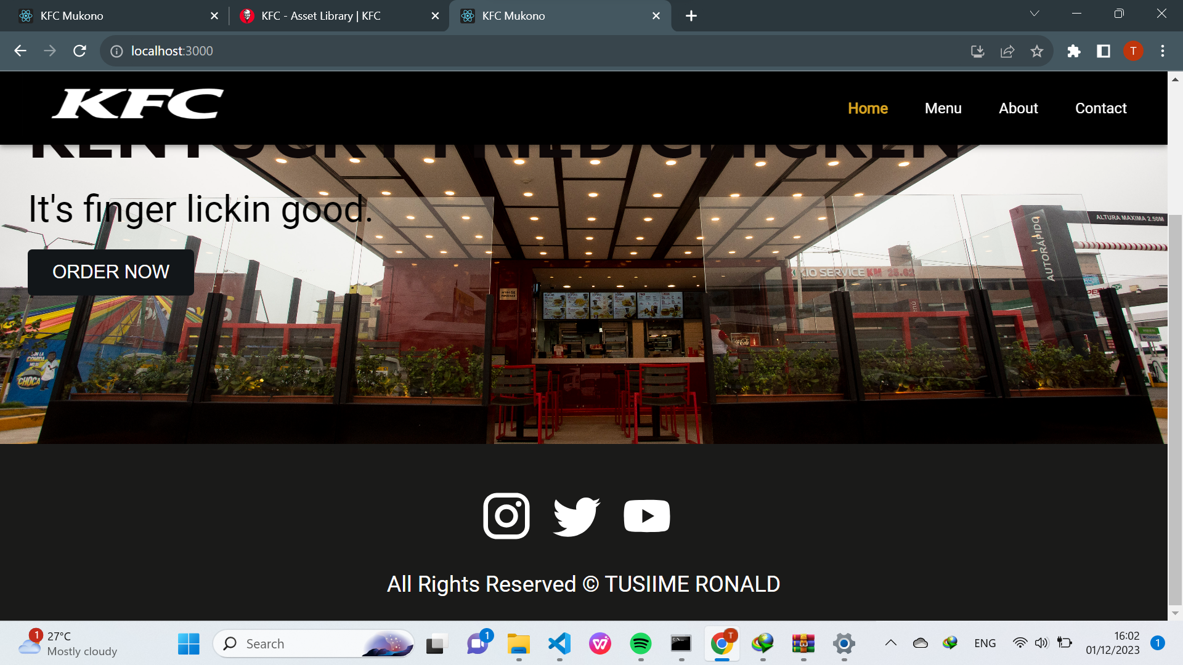
HOME PAGE

Slide 4
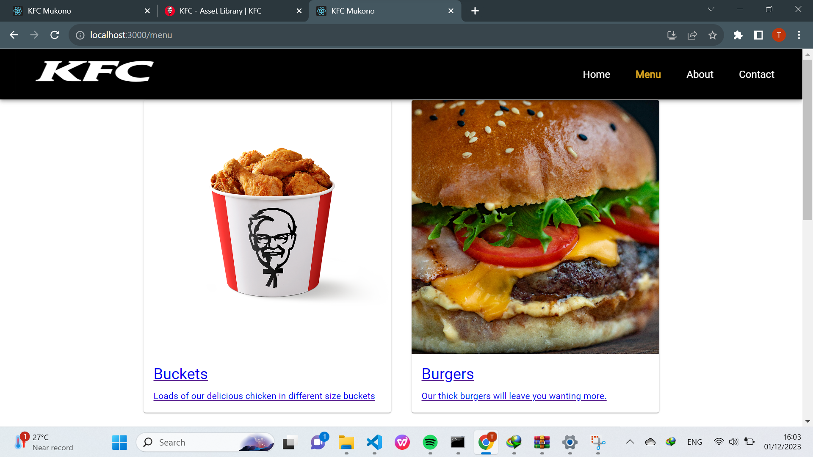
MENU PAGE

Slide 5
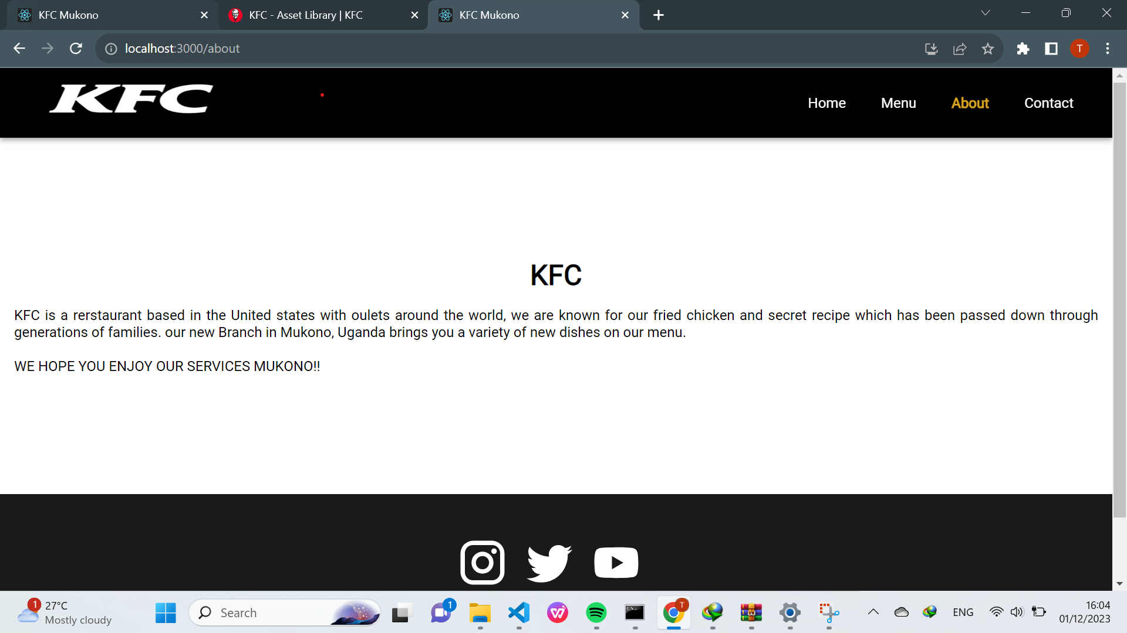
ABOUT US

Slide 6
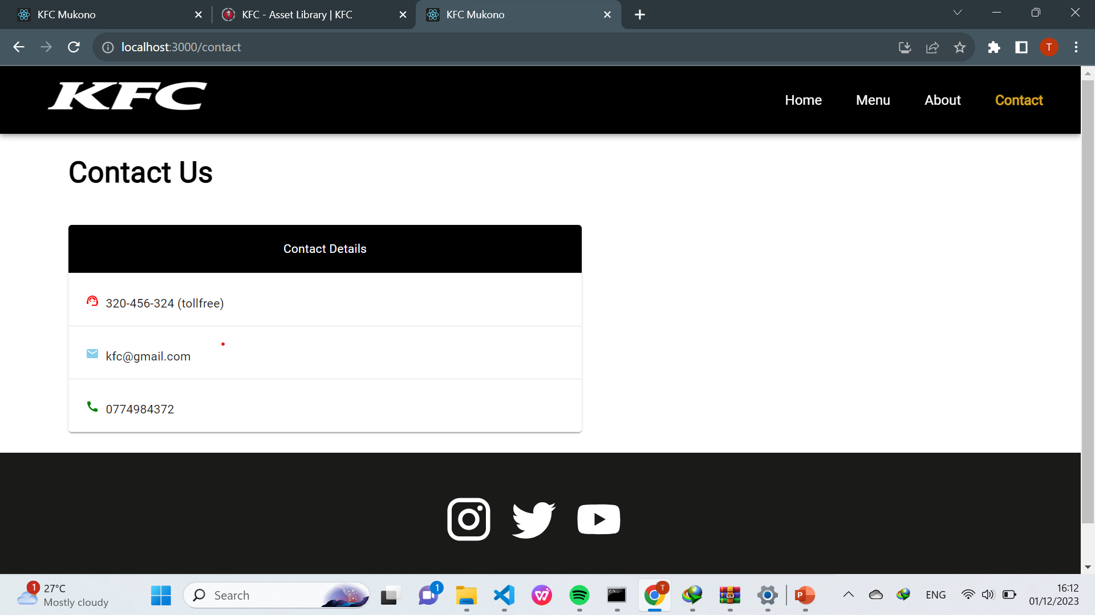
CONTACT

Slide 7
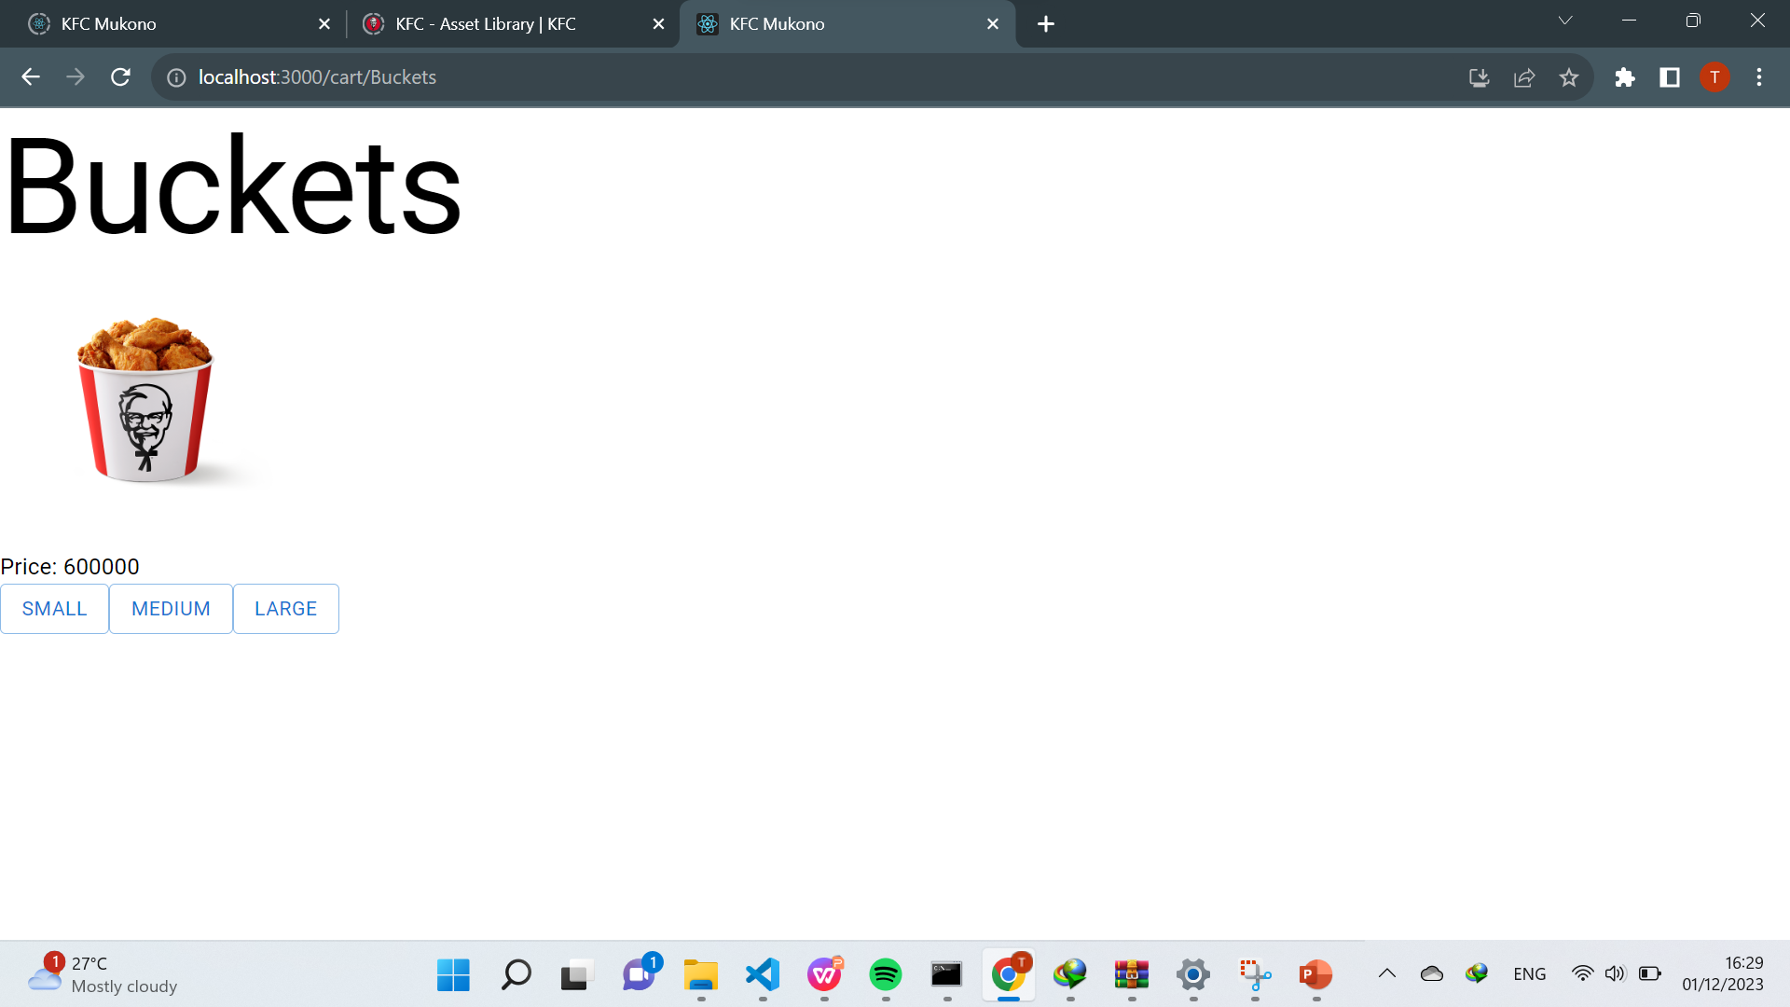
CART

Slide 8
GITHUB REPOSITORY

